Slide 1
Failed Banking Transaction Analysis
Presented By
CH.GOWTHAMI

Slide 2
Abstract
This project focuses on analyzing failed banking transactions from 15 branches across 3 cities. All files are uploaded to Google Cloud Storage.
Using PySpark on a Dataproc cluster, the data is cleaned by removing blank and null rows, then combined into a single file. Another PySpark job filters only the failed transactions, which are saved in Cloud SQL (MySQL).
Finally, the data is analyzed and visualized using BigQuery.
This project helps in understanding where and why transactions fail, using cloud tools for easy and fast processing.

Slide 3
Google Cloud Storage (GCS)
Google Cloud Storage is a scalable, secure, and durable object storage service that allows you to store and access data from anywhere.
How we used it in this project:
Uploaded CSV files from 15 bank branches using :-
“ gsutil ”
Stored raw data in :-
“ gs://gowthami-bucket/raw_data/ ”
Saved cleaned and filtered data in :-
“ gs://gowthami-bucket/cleaned_data/ “ and “ path/failed_transactions/ ”

Slide 4
Google Cloud Dataproc
Google Cloud Dataproc is a fast, scalable service for running Apache Spark and Hadoop jobs in a managed cloud environment.
How we used it in this project:
Run PySpark jobs on a single-node Dataproc cluster.
Cleaned the data by removing null/blank rows.
Collated data from multiple CSVs into one dataset.
Filtered failed transactions from cleaned data.

Slide 5
Google Cloud SQL
Cloud SQL is a fully-managed relational database service for MySQL, PostgreSQL, and SQL Server that handles backups, replication, and maintenance.
How we used it in this project:
Connected to a MySQL instance.
Loaded the filtered failed transactions into a table (failed_transactions).
Enabled structured storage of important transaction data.
Run SQL queries to identify:
Frequent failure locations
Failure trends over time
High-value failed transactions

Slide 6
Steps
Step 1 – Data Ingestion
Files uploaded to GCS bucket: gs://gowthami-bucket/raw_data/*.csv
Used gsutil to upload from local machine.
Step 2 – Data Cleaning & Collation (PySpark)
Script: clean_and_collate.py
Dropped rows with null or blank values using dropna().
Output stored in GCS: gs://gowthami-bucket/cleaned_data/
python
df = spark.read.option("header", True).csv("gs://gowthami-bucket/raw_data/*.csv") clean_df = df.dropna() clean_df.write.mode("overwrite").csv("gs://gowthami-bucket/cleaned_data/")

Slide 7
Step 3 – Filter Failed Transactions (PySpark)
Script: filter_failed_transactions.py
Filter condition: transaction_status == "FAILED"
Output saved to: gs://gowthami-bucket/output/failed_transactions/
python
failed_df = df.filter(df["transaction_status"] == "FAILED") failed_df.write.csv("gs://gowthami-bucket/output/failed_transactions/", header=True)
Step 4 – Load to Cloud SQL (Python + Pandas)
Script: load_failed_transactions.py
Read filtered CSV from GCS.
Connected to Cloud SQL (MySQL) and inserted into failed_transactions table.
Step 5 – Analysis in BigQuery
Import Cloud SQL table into BigQuery.
Create dashboards using Looker Studio .

Slide 8
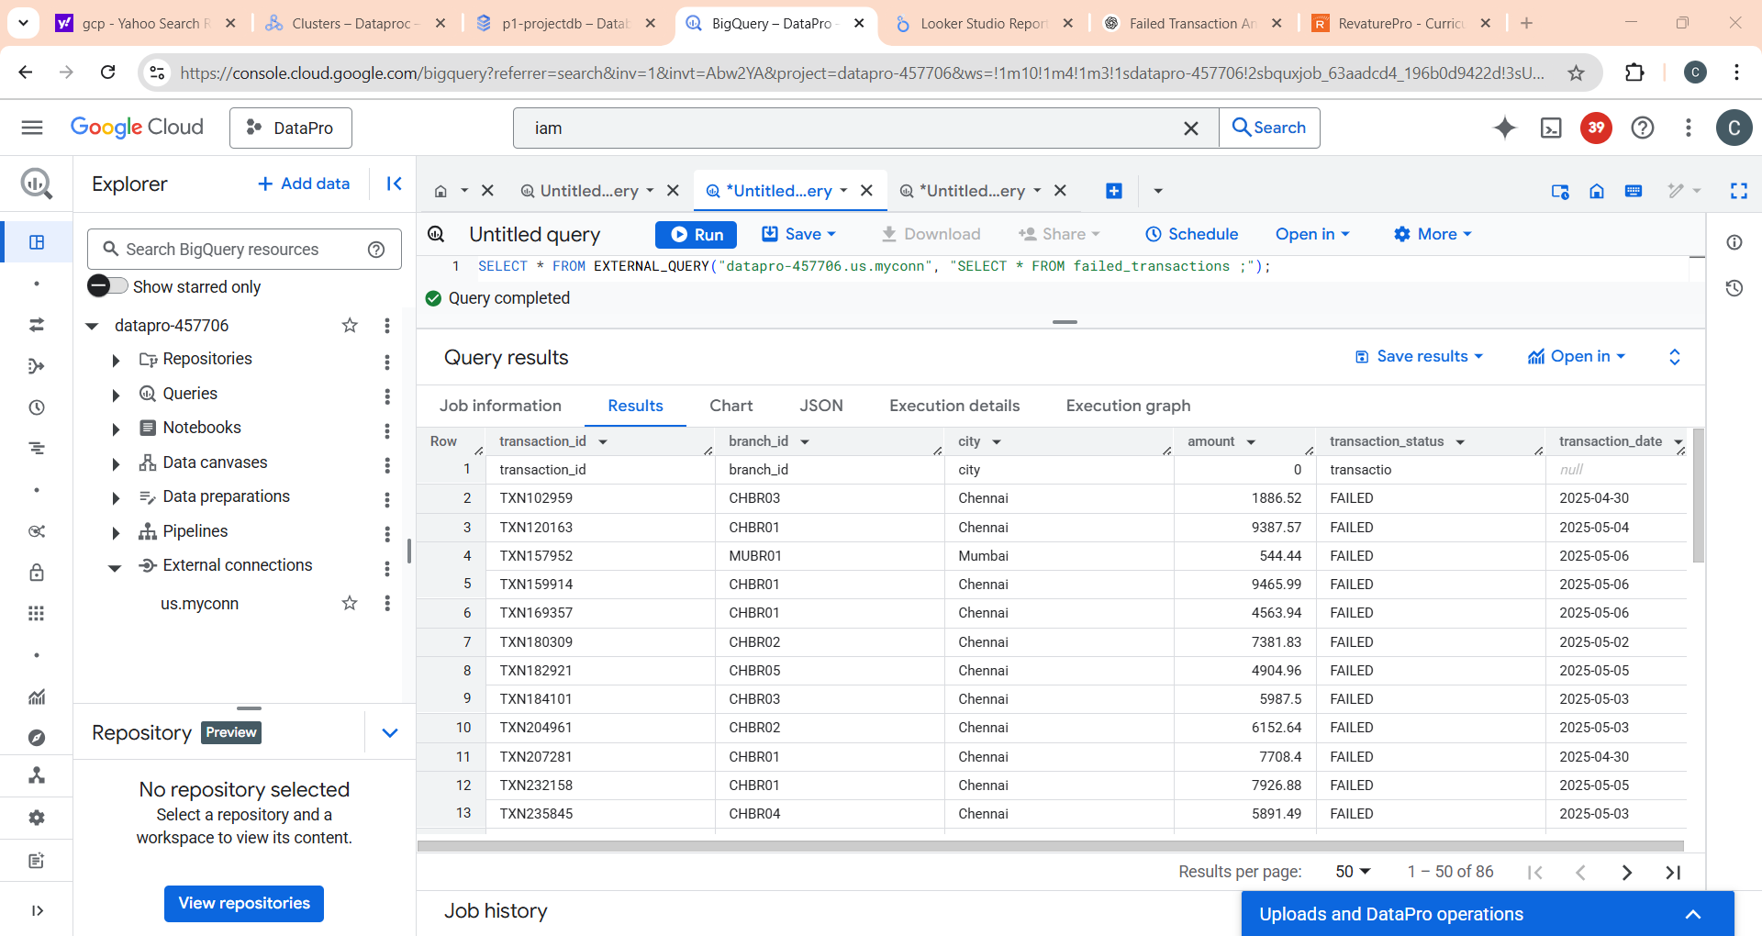
Running Queries In Big Query
SELECT * FROM EXTERNAL_QUERY("datapro-457706.us.myconn", "SELECT * FROM failed_transactions where city='Chennai';");

Slide 9
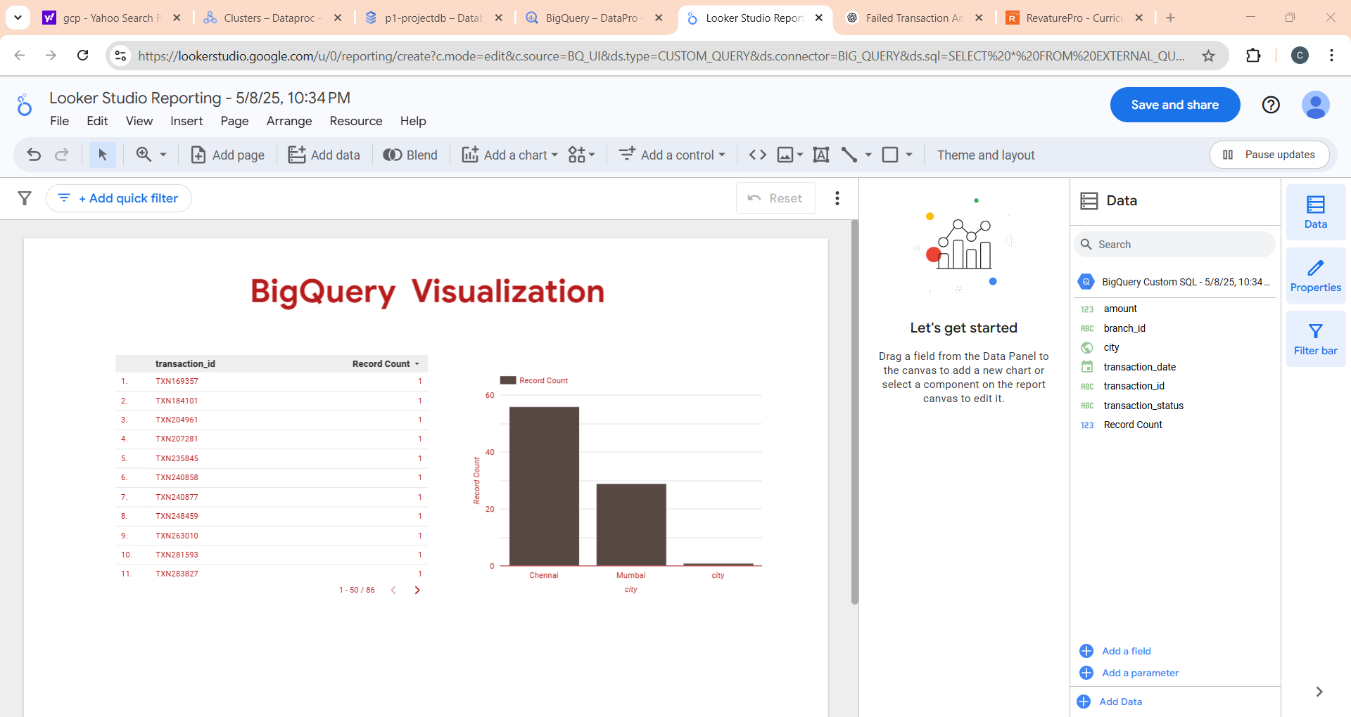

Slide 10
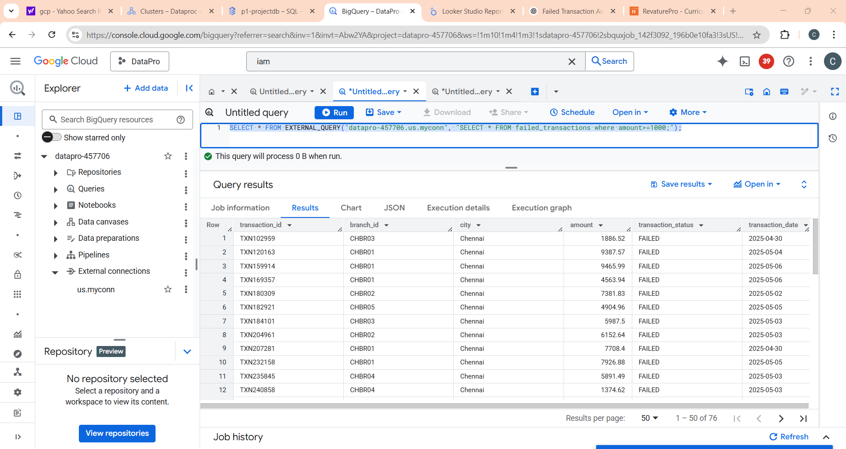
SELECT * FROM EXTERNAL_QUERY("datapro-457706.us.myconn", "SELECT * FROM failed_transactions where amount>=1000;");

Slide 11
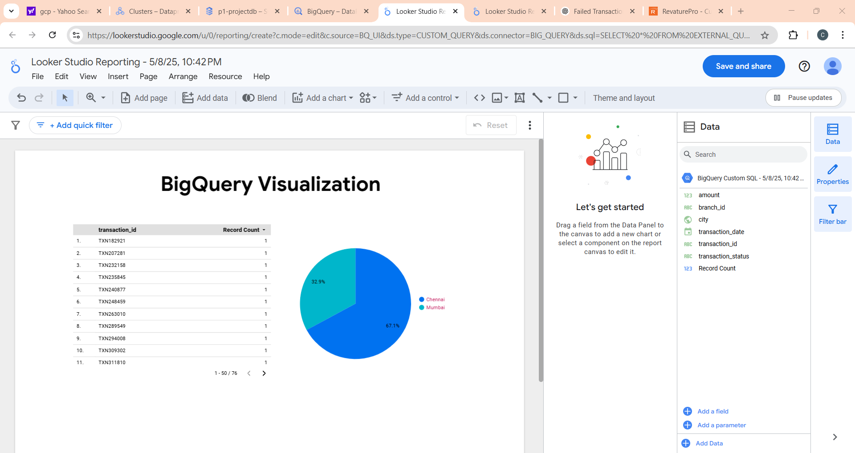

Slide 12
Conclusion
Successfully built a cloud-based data pipeline to handle real-world banking transaction data.
Used Google Cloud tools (GCS, Dataproc, Cloud SQL, BigQuery) for data ingestion, cleaning, storage, and analysis.
Identified failed transactions and analyzed patterns by city, branch, and amount.
Enabled faster insights through automated processing and visual dashboards.
This solution helps banks improve reliability, detect failure trends, and enhance decision-making.

Slide 13
Thank You

